Slide 1
Evaluation: test 6
Deel 1
Ontwerp ’n metode vir die klas SLL (agterop gedruk) genaamd: insertSorted() wat ’n element op die regte posisie in ’n gesorteerde lys sal voeg.
Vb Lys voor: {2,6,7,8}
insertSorted (3)
Vb lys na: {2,3,6,7,8}
Gebruik die 4 stap ontwerp metode (diagram, algemene en spesiale gevalle en kode)
Part 1
Design method for the class SLL (printed on reverse side) named: insertSorted() will add an element in the correct position in a sorted list. E.g. List before: {2,6,7,8}
insertSorted (3)
E.g. List after: {2,3,6,7,8}
Use the 4 step design method (diagram; general, special cases and code)

Slide 2
public class SLL
{
private Element head; // list header
private Element tail;
public SLL()
{ head = null;
tail = null;
}
/* you may use the following methods without giving the code*/
public boolean append(Integer newElement)
public boolean prepend(Integer newElement)
public void showAll()
public class Element
{
private Integer data;
private Element next;
public Element(Integer param)
{
data = param;
}
}// end of inner class Node
}//end SinglyLinkedList outer class

Slide 3
Deel 2
Voltooi die toetsprogram om die insertSorted() metode deeglik te toets in Java
Part 2
Complete the test program to thoroughly test the insertSorted() method in Java
public class Driver
{
public static void main(String [] args)
{

Slide 4
Step 1.1 Basic diagram SLL
ABD2
1 | A20D
Data | Next
A20D
2 | 5B32
Data | Next
5B32
6 | 7EF2
Data | Next
7EF2
7 | Null
Data | Next
Head | ABD2
Step 1: Draw a diagram to aid your explanation
Start by drawing a standard linked list – note that in this case the list must be sorted.
Then add detail to support the question
Tail | 7EF2

Slide 5
Step 1.2 Add more detail
ABD2
1 | A20D
Data | Next
A20D
2 | 5B32
Data | Next
5B32
6 | 7EF2
Data | Next
7EF2
7 | Null
Data | Next
Head | ABD2
newItem
prevPtr | A20D
ptr | 5B32
AB02
3 | Null
Data | Next
Tail | 7EF2
If (newItem.data > prevPtr.data && newItem.data < ptr.data)

Slide 6
Step 1.3 Detail of general solution
ABD2
1 | A20D
Data | Next
A20D
2 | 5B32 AB02
Data | Next
5B32
6 | 7EF2
Data | Next
7EF2
7 | Null
Data | Next
Head | ABD2
newItem
prevPtr | A20D
ptr | 5B32
AB02
3 | Null 5B32
Data | Next
Tail | 7EF2
If (newItem.data > prevPtr.data && newItem.data < ptr.data)

Slide 7
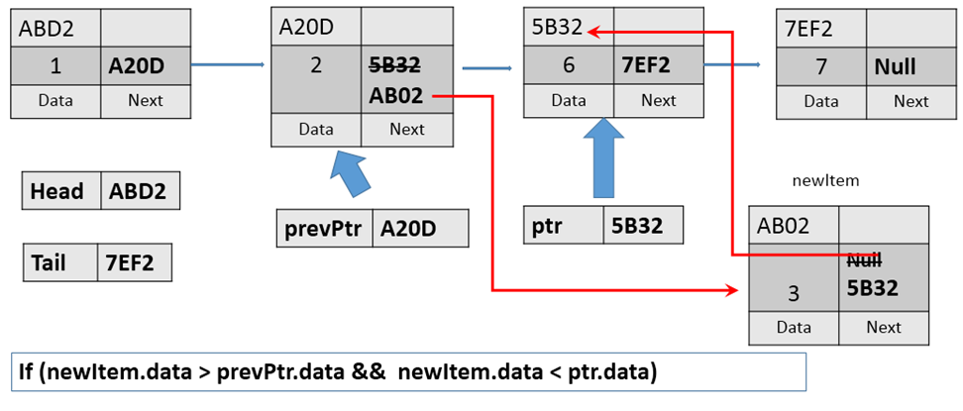
Step 2: General case
Specify general case: Assume the number should be added somewhere in the middle of the list
Specify actions:
Create a new element to insert in list –called NewItem
Traverse the list from the start using 2 pointers: prevPtr and ptr
Test each element :
If (newItem.data > prevPtr.data && newItem.data < ptr.data)
position is found – insert element
else – advance prevPtr and ptr
prevPtr = ptr
ptr= ptr.next
Add element by:
prevPtr.next = newItem
newItem.next = ptr

Slide 8

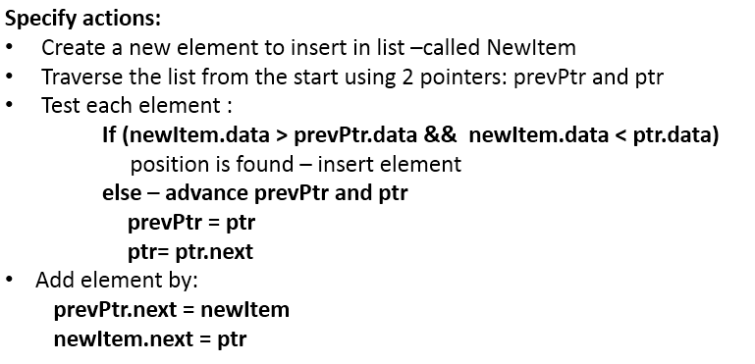
Step 2: General case
Specify general case: Assume the number should be added somewhere in the middle of the list
public boolean intsertSorted(Integer item){
Element ptr = head;
Element prevPtr = null;
Element newItem;
……
boolean inserted = false;
newItem= new Element(item);
ptr= head.next;// start with second element
prevPtr= head;
while (ptr!= null && !inserted)
{
if (newItem.data.compareTo(prevPtr.data)>=0 && newItem.data.compareTo(ptr.data)<=0)
{
newItem.next = ptr;
prevPtr.next = newItem;
inserted = true;
}
prevPtr=ptr;
ptr= ptr.next;
}
return inserted;

Slide 9
Step 2: General case
Specify general case: Assume the number should be added somewhere in the middle of the list
boolean inserted = false;
newItem= new Element<T>(item);
ptr= head.next;// start with second element
prevPtr= head;
while (ptr!= null && !inserted)
{
if (newItem.data.compareTo(prevPtr.data)>=0 && newItem.data.compareTo(ptr.data)<=0)
{
newItem.next = ptr;
prevPtr.next = newItem;
inserted = true;
}
prevPtr=ptr;
ptr= ptr.next;
}
return inserted;

Slide 10
Step 3: Special cases
Specify all special cases:
List can be empty
New Item might be smaller than the first element
New Item might be larger than last element
New Element equal to existing element
IMPORTANT: You should also indicate the actions for each special case.
Note: Although special cases are typically around the ends of the list, other special cases might also occur – such as the list has an even number of items in a method that should return the middle value… You need to think carefully in each problem – do not assume you know what they are in advance!

Slide 11
Special case 1. List can be empty
Head | Null AB02
newItem
AB02
-3 | Null
Data | Next
Tail | Null AB02
If (head == null)

Slide 12
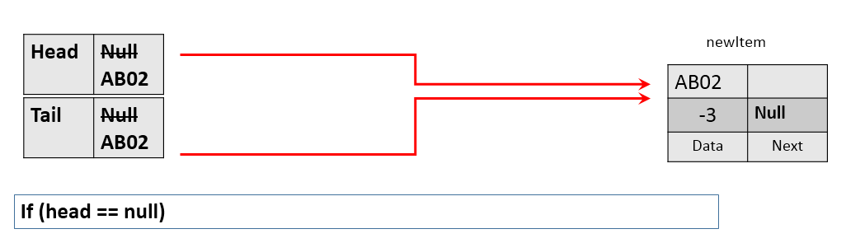
Special case 1. List can be empty
Check to see if list is empty
Add new element by using append(item)
Note that append uses the Integer as parameter and not a new Element – append(item) will update head and tail.
if (head == null)
{
append (item);
return true;
}

Slide 13
Special case 2. Item is smaller than head
ABD2
1 | A20D
Data | Next
A20D
2 | 5B32
Data | Next
5B32
6 | 7EF2
Data | Next
7EF2
7 | Null
Data | Next
Head | ABD2 AB02
newItem
AB02
-3 | Null ABD2
Data | Next
Tail | 7EF2
if (item< head.data)

Slide 14
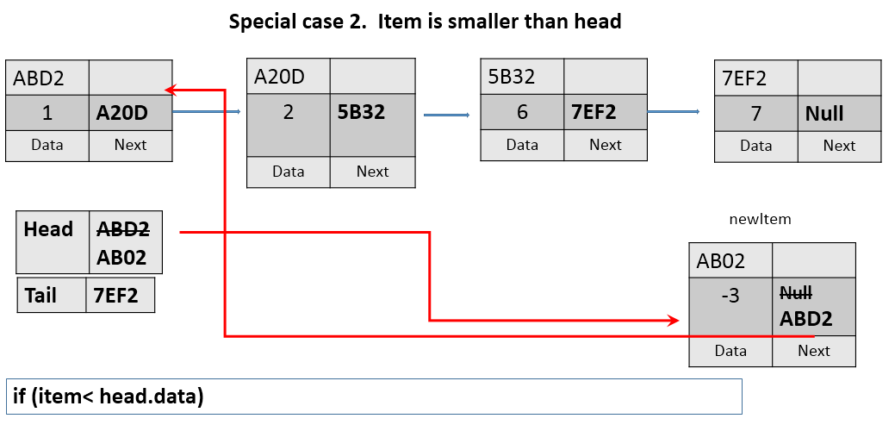
Special case 2. Item is smaller than head
Check to see if item is smaller than head.data
Add new element by using prepend(item)
Note that prepend uses the Integer as parameter and not a new Element – prepend(item) will update head and tail.
if (item.compareTo(head.data)<0)
{
prepend(item);
return true;
}

Slide 15
Special case 3. Item is larger than tail
ABD2
1 | A20D
Data | Next
A20D
2 | 5B32
Data | Next
5B32
6 | 7EF2
Data | Next
7EF2
7 | Null AB02
Data | Next
Head | ABD2
newItem
AB02
10 | Null
Data | Next
Tail | 7EF2 AB02
if (item>tail.data)

Slide 16
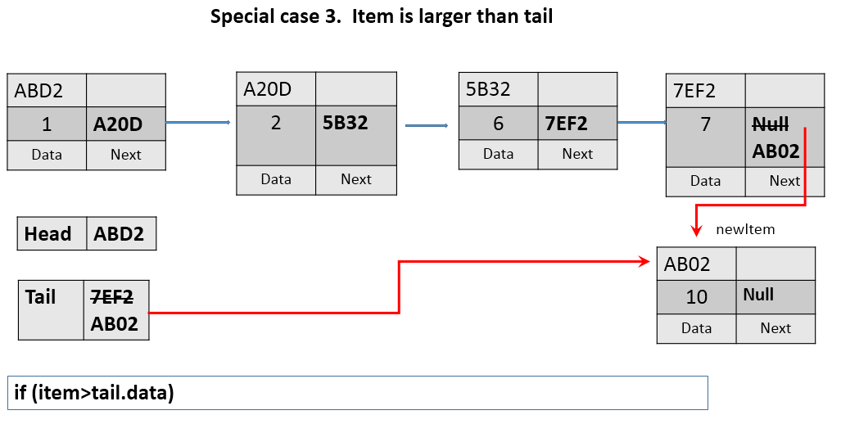
Special case 3. Item is larger than tail
Check to see if item is larger than tail.data
Add new element by using append(item)
Note that append uses the Integer as parameter and not a new Element – prepend(item) will update head and tail.
if (item.compareTo(tail.data)>=0)
{
append(item);
return true;
}

Slide 17
Special case 4. New item equal to existing item
ABD2
1 | A20D
Data | Next
A20D
2 | 5B32 AB02
Data | Next
5B32
6 | 7EF2
Data | Next
7EF2
7 | Null
Data | Next
Head | ABD2
newItem
prevPtr | A20D
ptr | 5B32
AB02
6 | Null 5B32
Data | Next
Tail | 7EF2
If (newItem.data >= prevPtr.data && newItem.data <= ptr.data)

Slide 18
public boolean intsertSorted(Integer item) { Element ptr = head; Element prevPtr = null; Element newItem; boolean inserted = false; if (head == null) { append (item); return true; } if (item.compareTo(head.data)<0) { prepend(item); return true; } if (item.compareTo(tail.data)>=0) { append(item); return true; } newItem= new Element(item); ptr= head.next;// start with second element prevPtr= head; while (ptr!= null && !inserted) { if (newItem.data.compareTo(prevPtr.data)>=0 && newItem.data.compareTo(ptr.data)<=0) { newItem.next = ptr; prevPtr.next = newItem; inserted = true; } prevPtr=ptr; ptr= ptr.next; } return inserted; }
Complete code

Slide 19
public class Driver { public static void main(String [] args) { SLL myList = new SLL(); System.out.println("\n Initial list: "); myList.showAll(); System.out.println("\n Add one item: "); myList.intsertSorted(new Integer(3)); myList.showAll(); System.out.println("\n Add One smaller than first one:"); myList.intsertSorted(new Integer(2)); myList.showAll(); System.out.println("\n Add One larger than the last one:"); myList.intsertSorted(new Integer(9)); myList.showAll(); System.out.println("\n Add One in the middle:"); myList.intsertSorted(new Integer(5)); myList.showAll(); } }
TEST code –all the special cases

Slide 20
TEST code –all the special cases

